Slide 1
C Instructions

Slide 2
Three types of instructions in C:
Type Declaration Instruction
Arithmetic Instruction
Control Instruction

Slide 3
The purpose of each of these instructions is given
a)Type declaration instruction-To declare the type of variables used in a C program.
b) Arithmetic instruction − To perform arithmetic operations between constants and variables.
c)Control instruction − To control the sequence of execution of various statements in a C program.

Slide 4
Type Declaration Instruction
Any variable used in the program must be declared
before using it in any statement. The type declaration statement is
written at the beginning of main( ) function.
Ex.: int bas ;
float rs, grosssal ;
char name, code ;

Slide 5
While declaring the type of variable we can also initialize it as shown below.
int i = 10, j = 25 ;
float a = 1.5, b = 1.99 + 2.4 * 1.44 ;

Slide 6
The order in which we define the variables is sometimes
important sometimes not. For example,
int i = 10, j = 25 ;
is same as
int j = 25, j = 10 ;
However,
float a = 1.5, b = a + 3.1 ;
is alright, but
float b = a + 3.1, a = 1.5 ;

Slide 7
(c) The following statements would work
int a, b, c, d ;
a = b = c = 10 ;
However, the following statement would not work
int a = b = c = d = 10 ;
Once again we are trying to use b (to assign to a) before defining it

Slide 8
Arithmetic Instruction
A C arithmetic instruction consists of a variable name on the left hand side of = and variable names & constants on the right hand
side of =.
The variables and constants appearing on the right handside of = are connected by arithmetic operators like +, -, *, and /

Slide 9
Ex.: int ad ;
float kot, deta, alpha, beta, gamma ;
ad = 3200 ;
kot = 0.0056 ;
deta = alpha * beta / gamma + 3.2
, /, -, + are the arithmetic operators.
= is the assignment operator.
2, 5 and 3200 are integer constants.
3.2 and 0.0056 are real constants.
ad is an integer variable.
kot, deta, alpha, beta, gamma are real variables. * 2 / 5 ;

Slide 10
A C arithmetic statement could be of three types. These are as follows:
Integer mode arithmetic statement - This is an arithmetic statement in which all operands are either integer variables or integer constants.
Ex.: int i, king, issac, noteit ;
i = i + 1 ;
king = issac * 234 + noteit - 7689 ;

Slide 11
Real mode arithmetic statement- This is an arithmetic
statement in which all operands are either real constants or real variables.
Ex.: float qbee, antink, si, prin, anoy, roi ;
qbee = antink + 23.123 / 4.5 * 0.3442 ;
si = prin * anoy * roi / 100.0 ;

Slide 12
Mixed mode arithmetic statement - This is an arithmetic statement in which some of the operands are integers and some of the operands are real.
Ex.: float si, prin, anoy, roi, avg ;
int a, b, c, num ;
si = prin * anoy * roi / 100.0 ;
avg = ( a + b + c + num ) / 4 ;

Slide 13
Integer and Float Conversion:
a)An arithmetic operation between an integer and integer
always yields an integer result.
b)An operation between a real and real always yields a real
result.
c)An operation between an integer and real always yields a real result.
In this operation the integer is first promoted to a real
and then the operation is performed

Slide 14
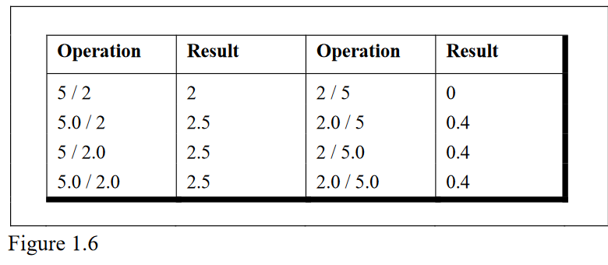

Slide 15
Type Conversion in Assignments
It may so happen that the type of the expression and the type of the variable on the left-hand side of the assignment operator may not be same.
For example, consider the following assignment statements.
int i ;
float b ;
i = 3.5 ;
b = 30 ;

Slide 16
Here in the first assignment statement though the expression’s value is a float (3.5) it cannot be stored in i since it is an int.
In such a case the float is demoted to an int and then its value is stored.
Hence what gets stored in i is 3. Exactly opposite happens in the next statement.
Here, 30 is promoted to 30.000000 and then
stored in b, since b being a float variable cannot hold anything except a float value

Slide 17
Hierarchy of Operations
While executing an arithmetic statement, which has two or more operators.
For example, does the expression 2 * x - 3 * y
correspond to (2x)-(3y) or to 2(x-3y)? Similarly, does A / B * C correspond to A / (B * C) or to (A / B) * C? T

Slide 19
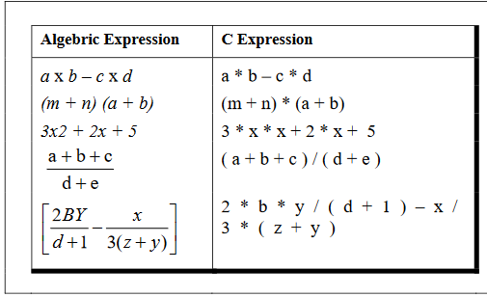

Slide 20
Associativity of Operators
Associativity can be of two types—
Left to Right or Right to Left.
Left to Right associativity means that the left operand must be

Slide 21
Consider the expression
a = 3 / 2 * 5 ;
Here there is a tie between operators of same priority, that is between / and *.
This tie is settled using the associativity of / and *.

Slide 22
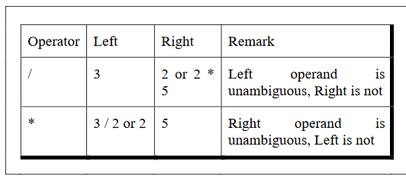

Slide 23
Control Instructions in C
In other words the control instructions determine the ‘flow of control’ in a program.
There are four types of control instructions in C.
They are
Sequence Control Instruction
(b) Selection or Decision Control Instruction
(c) Repetition or Loop Control Instruction
(d) Case Control Instruction

Slide 24
The Sequence control instruction ensures that the instructions are executed in the same order in which they appear in the program.
Decision and Case control instructions allow the computer to take a decision as to which instruction is to be executed next.
The Loop control instruction helps computer to execute a group of statements repeatedly.

